Slide 1
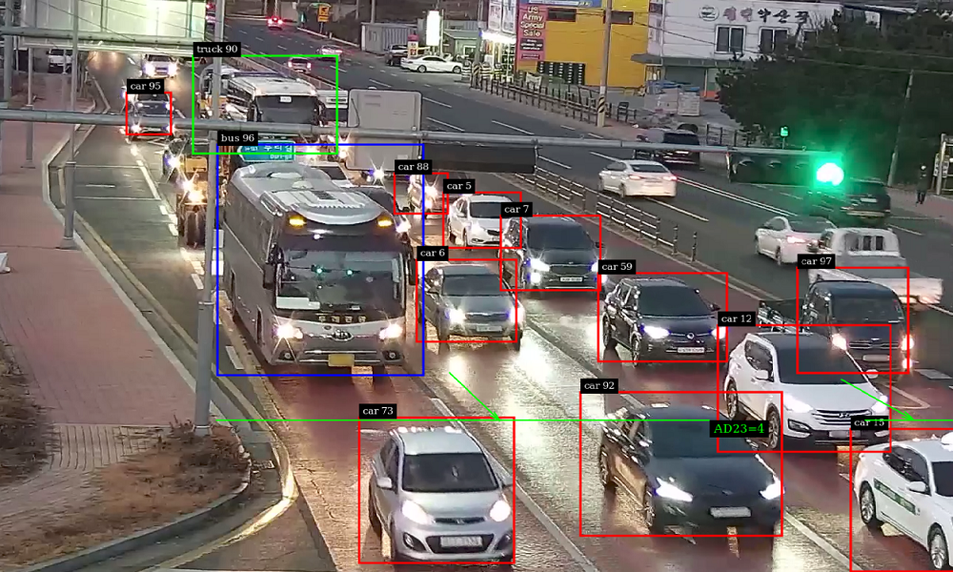
Traffic Detection System
Group 11
Rohan Hughes
Shih-Chi Han

Slide 2
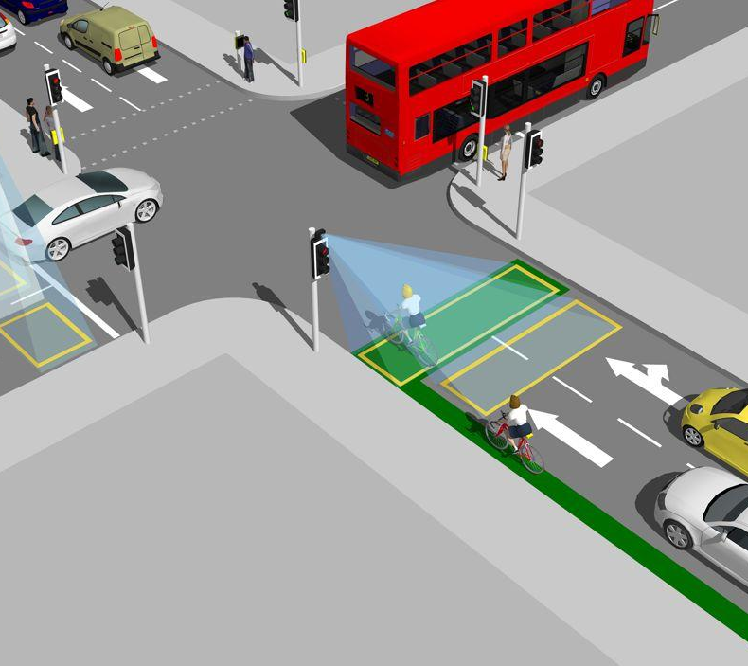
Introduction/Motivation
Traffic congestion and accidents are persistent challenges in urban areas
United States in 2022, 42,514 people died in motor vehicle crashes
(average of 120 people per day)
Drivers lose 42 hours on average in traffic
AI-based traffic monitoring system aims to reduce accidents, enhance traffic efficiency, facilitate quicker responses to incidents
Project proposes object detection techniques to analyze and predict traffic patterns

Slide 3
Past Solutions
Road safety regulations - speed limits, seat belt laws, cracking down on drunk driving.
Infrastructure improvements - maintaining/improving road conditions, HOV lanes, public transit
Urban planning - walkable cities, improved cycling infrastructure
Technological advancement - Google Maps and Waze
Vehicle safety technology - airbags, anti-lock braking systems (ABS), electronic stability control (ESC), lane-keeping assist, automatic emergency braking, adaptive cruise control, collision avoidance systems
Self-driving cars

Slide 4
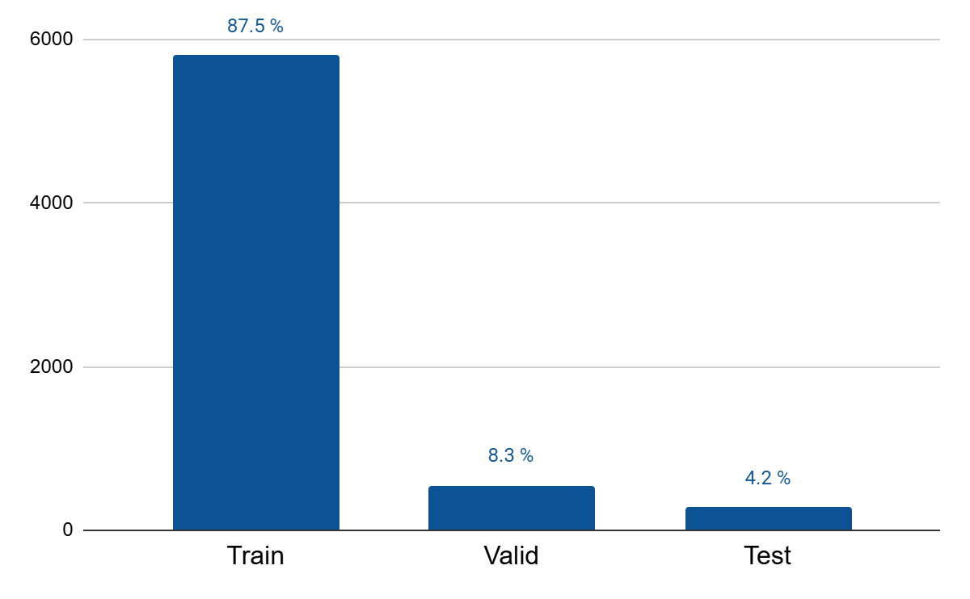
Dataset Description
Source: "Traffic Detection Project" on Kaggle
Dataset:
Train: 5805 image and label files
Valid: 549 image and label files
Test: 279 image and label files

Slide 5
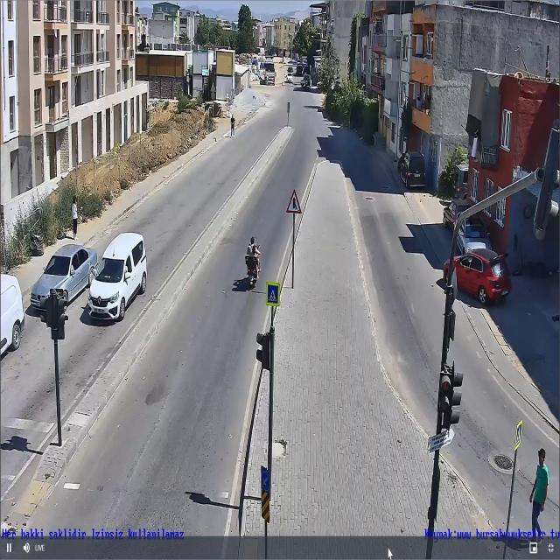
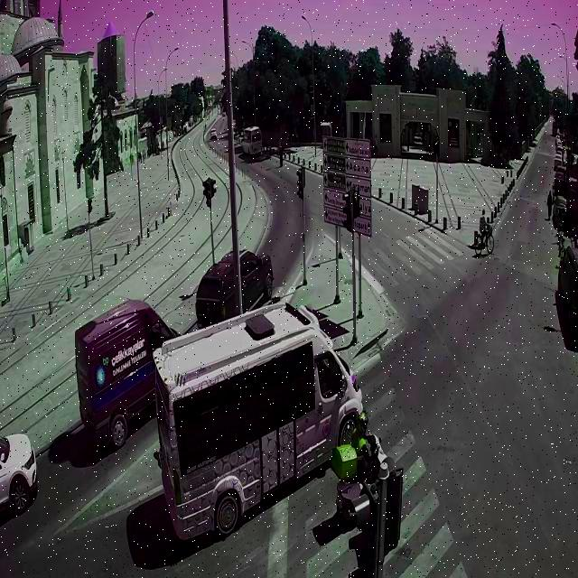

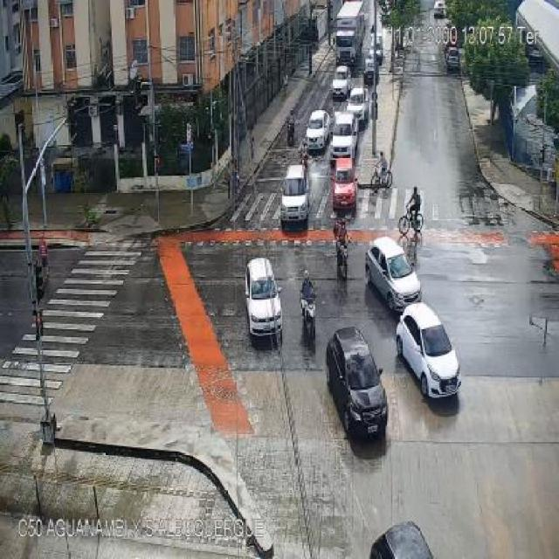
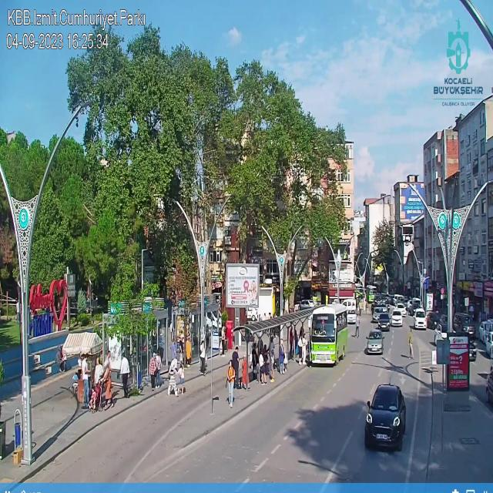

Dataset Description
Identify Objects
Bicycle, Bus, Car, Motorbike, Person
Environmental Conditions:
Weather, Lighting, and Traffic density

Slide 6

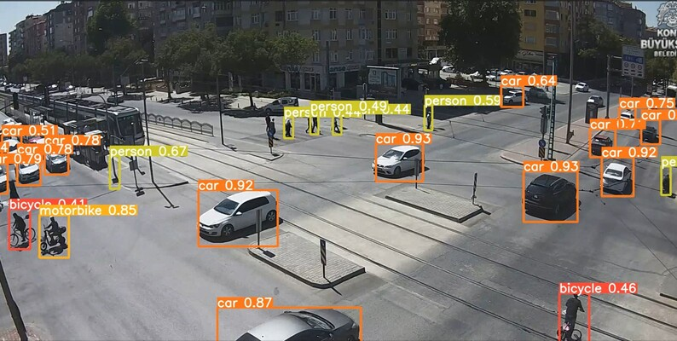
AI Methods
YOLOv5
You Only Look Once (YOLO) family of computer vision models
Commonly used for detecting objects
Four main versions:
small (s)
medium (m)
large (l)
extra large (x)

Slide 7
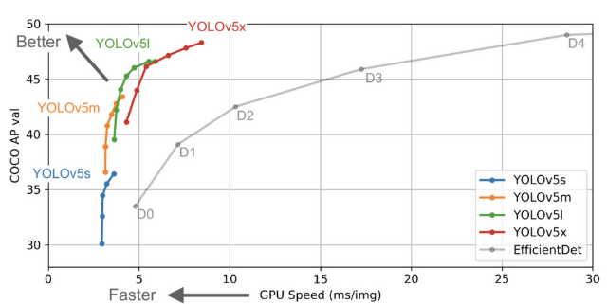
YOLOv5 Versions Comparison
Model | Size | Speed (FPS) | Accuracy (mAP) | Parameters
YOLOv5s | Small | Fastest | Lowest | ~7M
YOLOv5m | Medium | Faster | Higher than YOLOv5s | ~21M
YOLOv5l | Large | Slower | Higher than YOLOv5m | ~46M
YOLOv5x | Extra Large | Slowest | Highest | ~87M

Slide 8
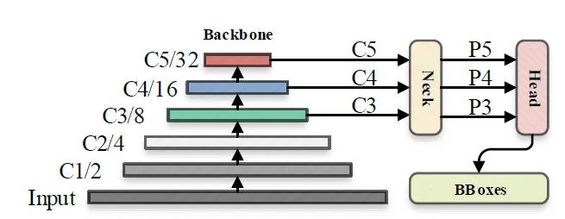
Overview of the YOLOv5 Architecture
Backbone (Feature Extractor)
Feature extraction
Neck (Feature Fusion)
Generate three feature maps P3, P4, and P5
Head (Prediction)
Object Classification
Confidence Scores
Bounding Box Regression

Slide 9
Implementation
Reduced training set to 1935 images, validation set to 183 images
Test set remained untouched
Used even smaller version for the weights - yolo5n
Resized images from 640x640 to 416x416
Reduced batch size to 8
Reduced the number of epochs from 50 to 20
Training the dataset took approximately 3 hours
Results were saved to csv file created automatically by model

Slide 10
Results
Precision score = 0.403
Recall = 0.634
Mean average precision (mAP) = 0.372.

Slide 11
Discussion
Precision score - model was not great at accurately classifying detected objects
Great at classifying buses and cars, but not people
Performed okay when classifying bicycles and motorbikes
Cars and buses are larger, perhaps easier to classify
Recall score - model wasn’t bad at identifying most of the relevant objects in an image
Low mAP score - model was not great at detecting objects across all the different classes

Slide 12
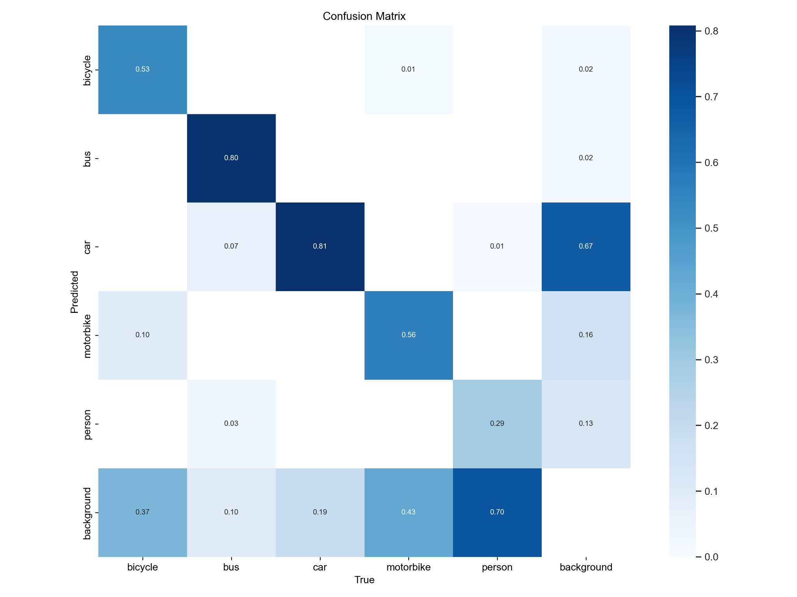
Confusion Matrix

Slide 13
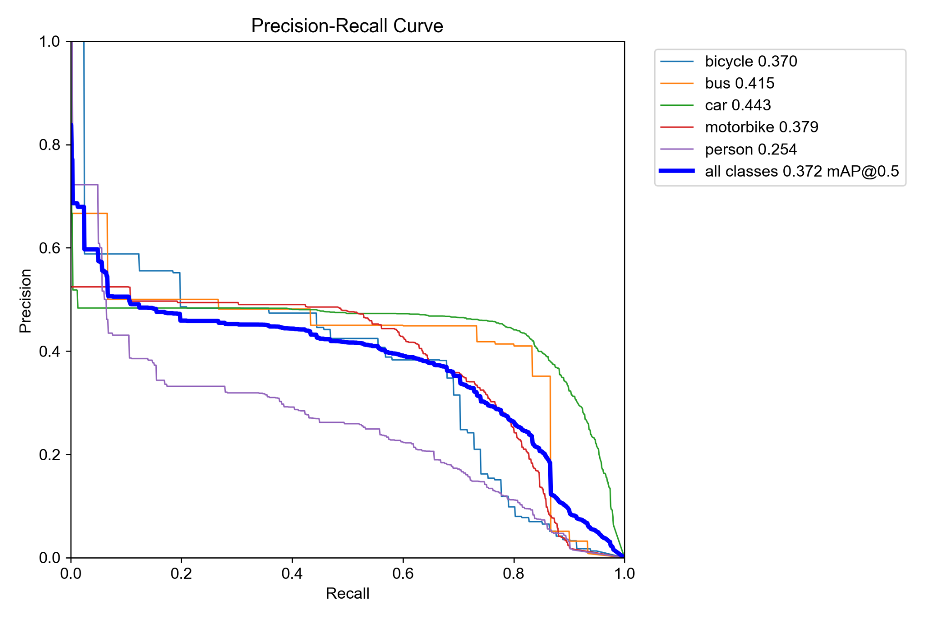
Precision-Recall Curve
Notes:
Precision recall curve indicates the trade off between the increase in recall and the decrease in precision. So as the recall value increases, that is, as more objects are added/as the model begins to identify more objects, it becomes less and less precise in terms of properly classifying the detected objects. As you can see, it performed the worse for people (lowest AUC) and the best for cars – larger AUC and higher threshold. Even as more objects are added, model is still able to properly identify a car.

Slide 14
Improvements
Model fell short in detecting smaller objects such as people and bicycles
Could be for several reasons - camera quality and the amount of zoom
Precision score increased only slightly across 20 epochs
Recall score climbed steadily

Slide 15
Conclusion
YOLOv5 can be viable method for reducing accidents and increasing traffic efficiency
Trigger alerts when it detects dangerous behavior
Optimize traffic light timings or route adjustments to smooth traffic flow
Automatically detect accidents and alert emergency services
Can be used to increase overall public safety

